Slide 1

Data Science Data based production optimization
Niklas Dicks
Jens Rosenkranz
Yara Mleis
Julien Kupplmayr
23.09.2022

Slide 2
Agenda
Data Science – Content and Application
Practical Example – Task
Data Preperation
Data Analysis
Data Visualization and Results

Slide 3
1. Data Science – Content and Application
Extraction of knowledge from data
Data collection, data cleaning, data preperation
and data analysis
Identification of anomalies
Optimize decision-making processes
„Python“ or „R“ are usual programming languages
Visualization of data

Slide 4


2. Practical example – Task
Entrepreneur hires a consulting firm
Show potential for improvement
Production data are already given
„Python“ as programming language
„Pandas“ as program library

Slide 5
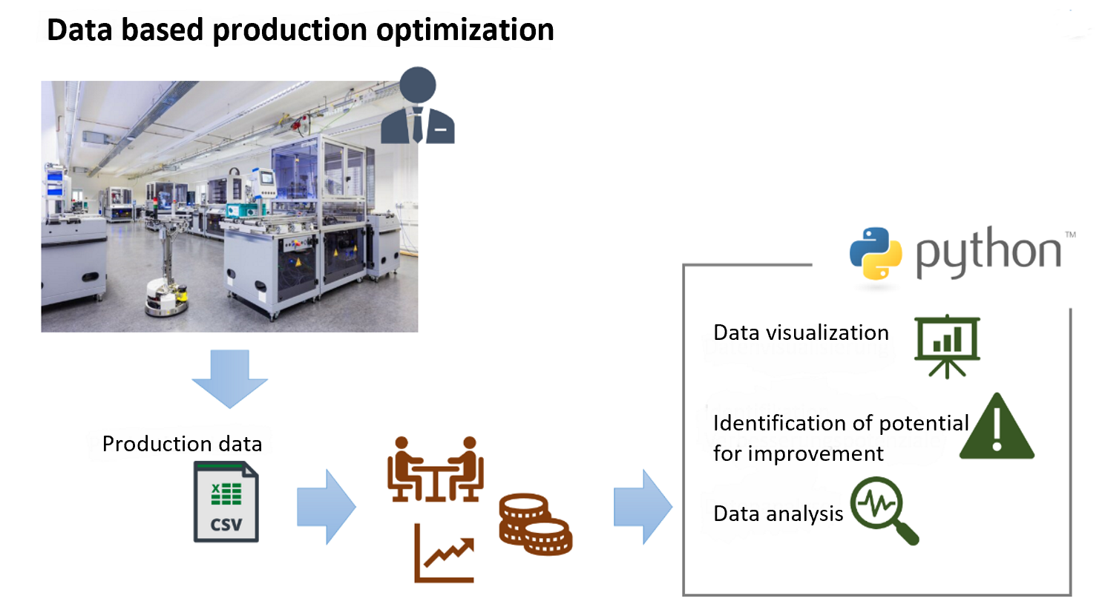
2. Practical example – Task

Slide 6
3. Data preperation
Tidying up data includes cleansing and manipulation
i.e. harmonizing Datatypes, removing leading spaces, adding calculated data
A consistent structure allows to focus on the data analysis

Slide 7
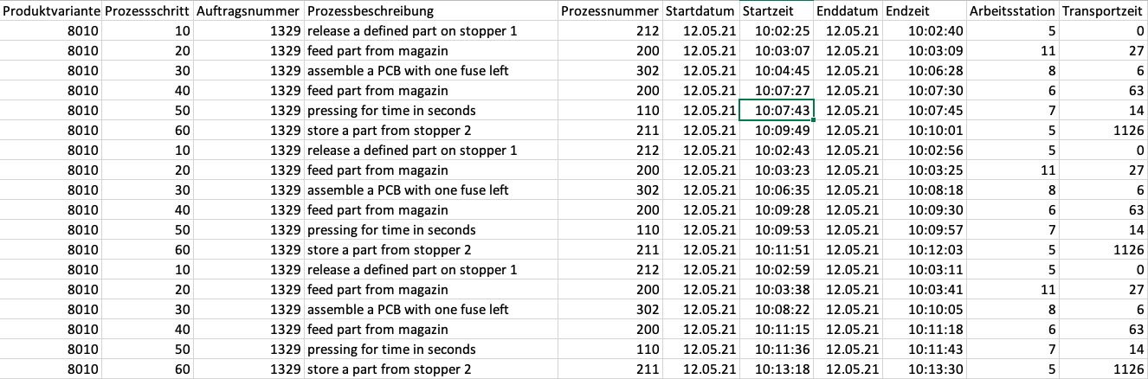
3. Data preperation

Slide 8
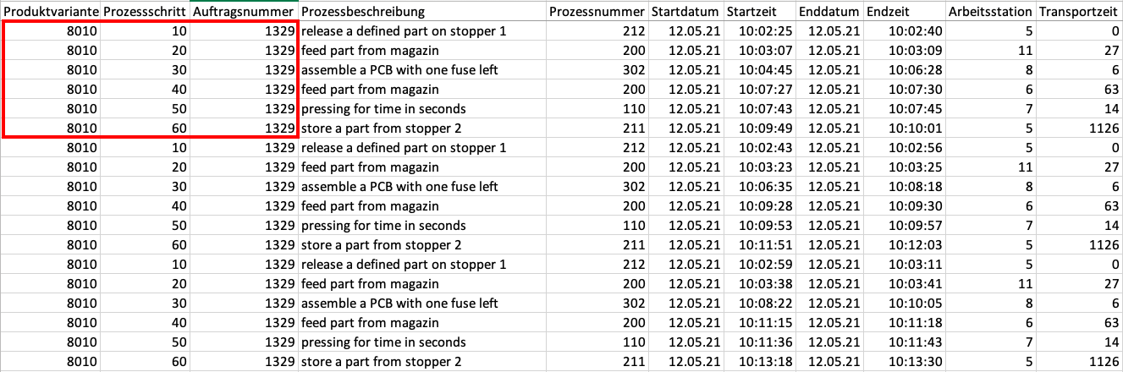
3. Data preperation

Slide 9
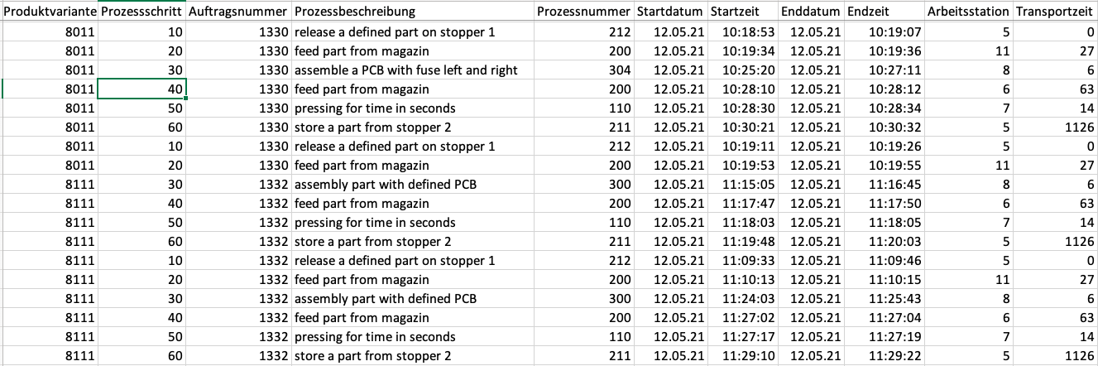
3. Data preperation

Slide 10
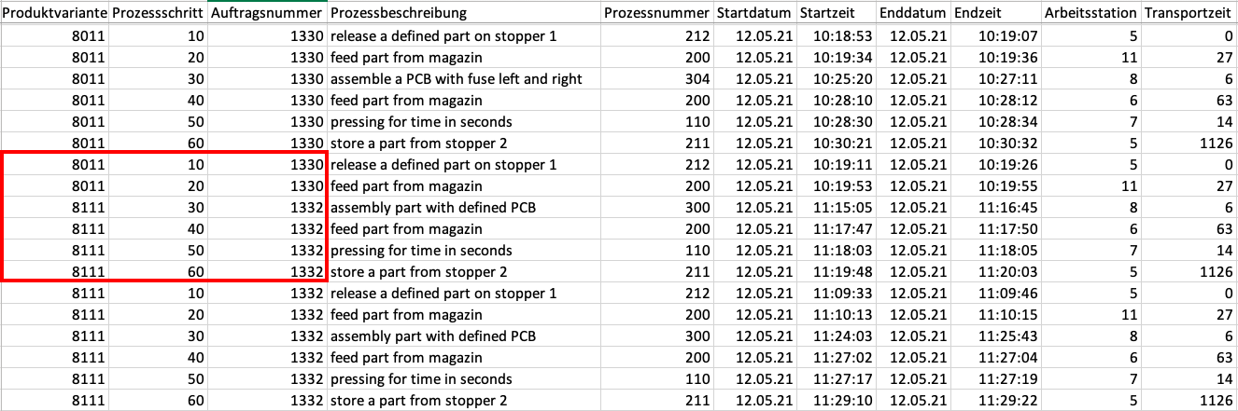
3. Data preperation

Slide 11
3. Data preperation

Slide 12
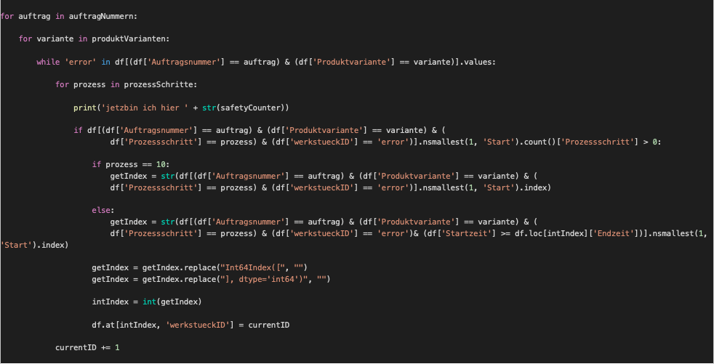
3. Data preperation

Slide 13
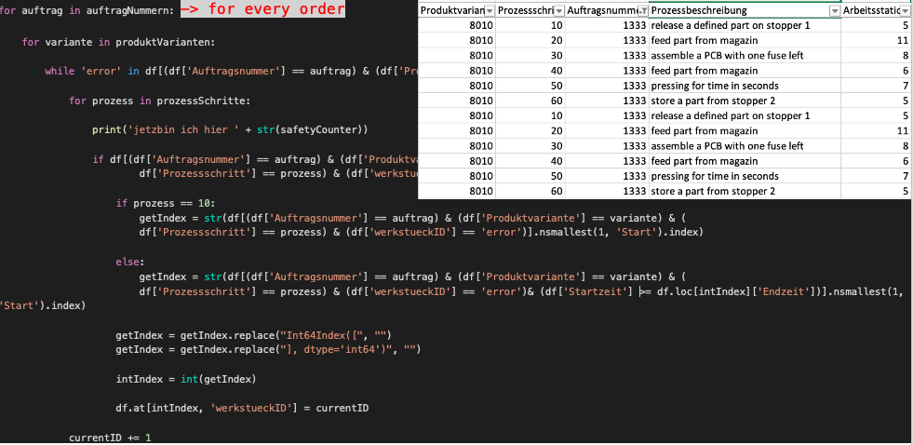
3. Data preperation

Slide 14
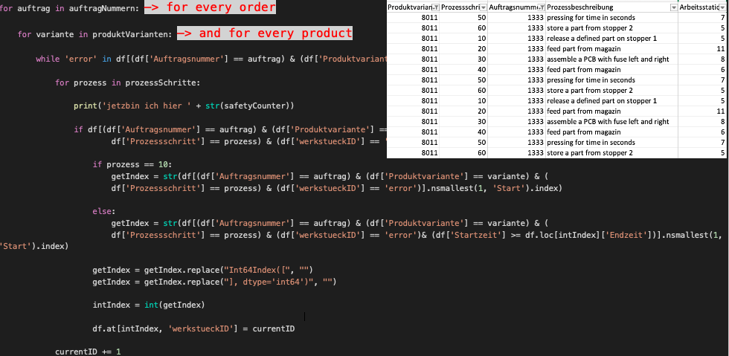
3. Data preperation

Slide 15
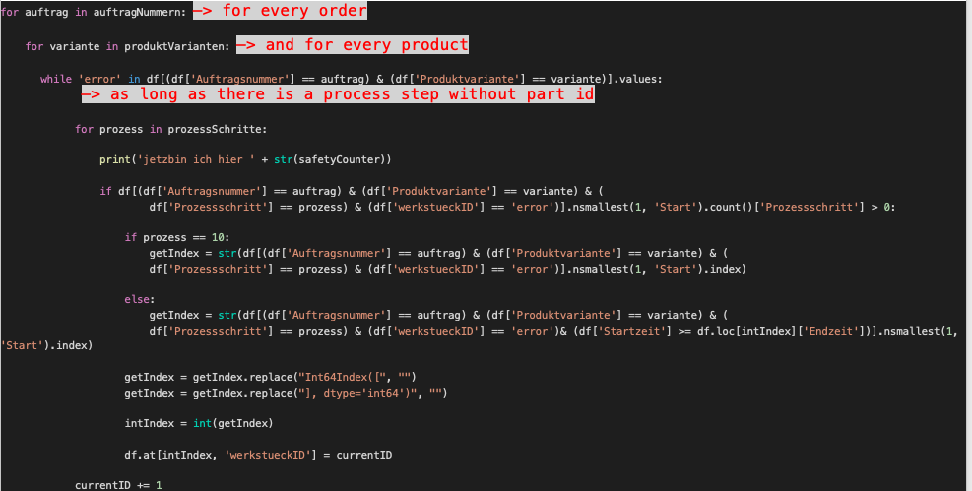
3. Data preperation

Slide 16
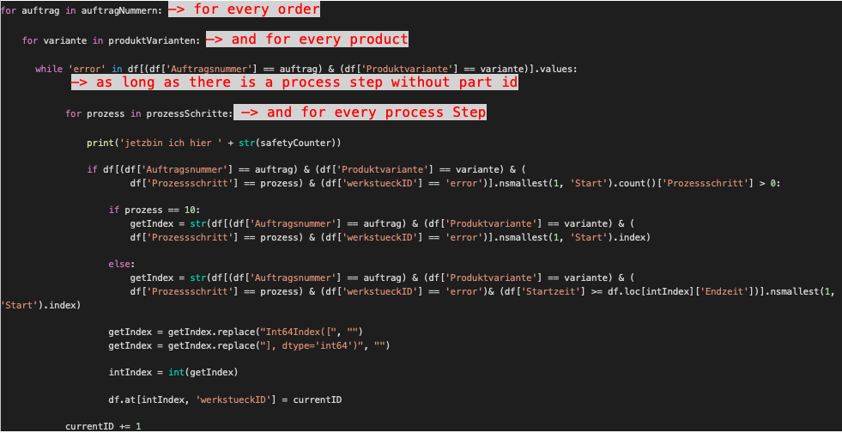
3. Data preperation

Slide 17
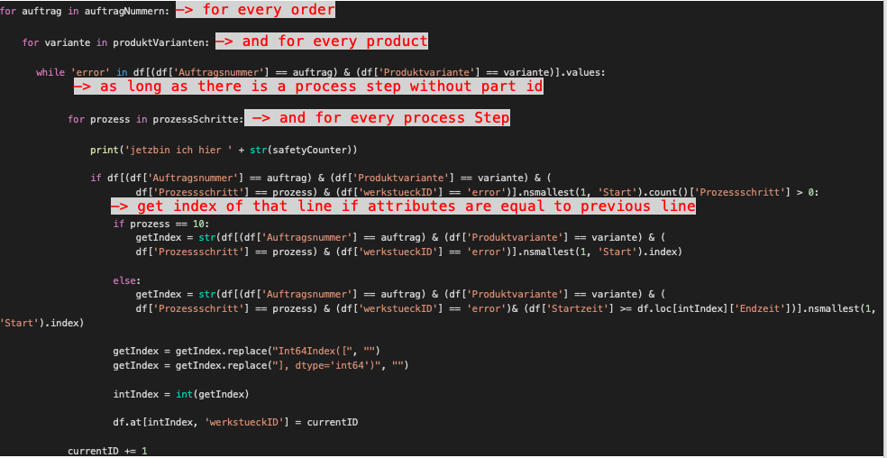
3. Data preperation

Slide 18
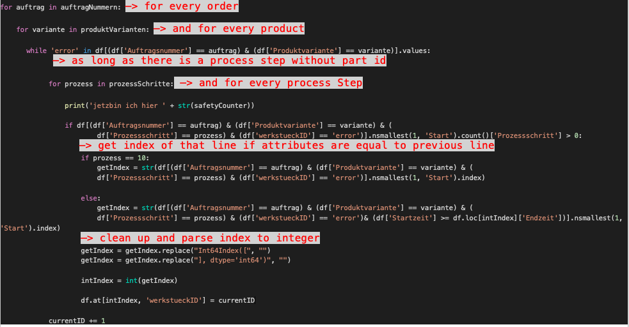
3. Data preperation

Slide 19
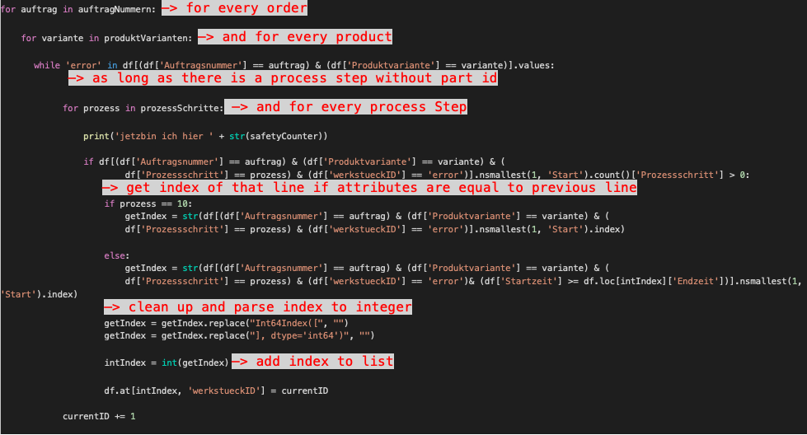
3. Data preperation

Slide 20
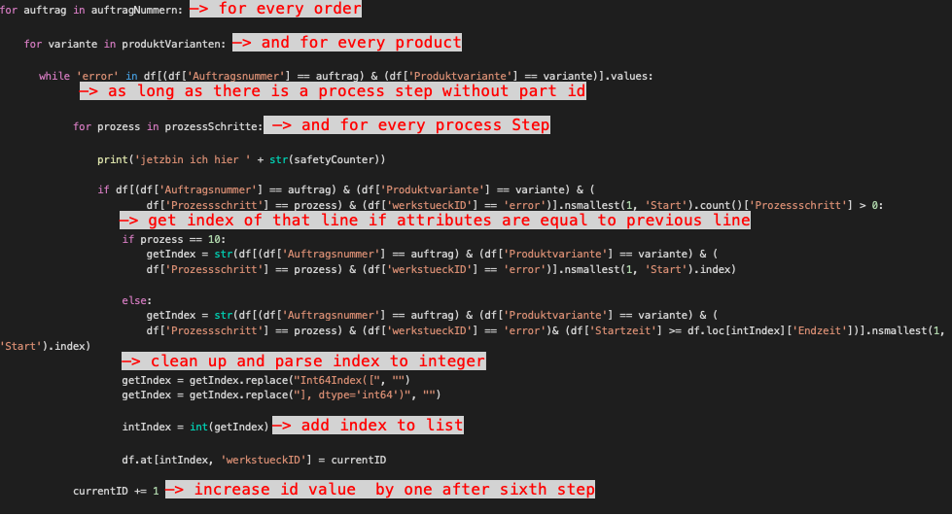
3. Data preperation

Slide 21
3. Data preperation

Slide 22
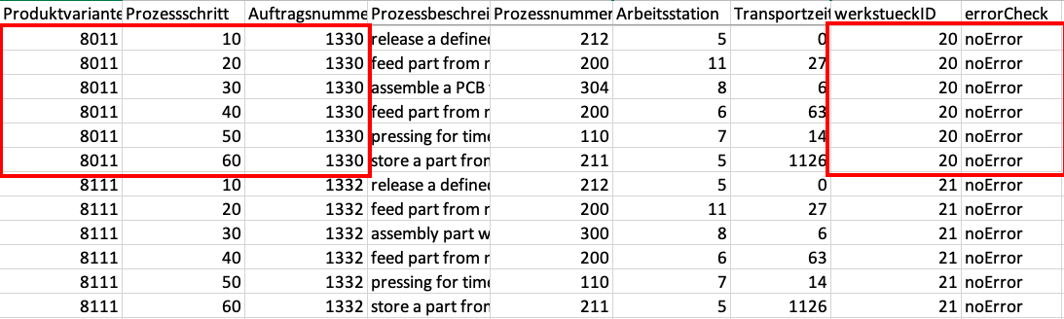
3. Data preperation

Slide 23

4. Data analysis
Lead time

Slide 24
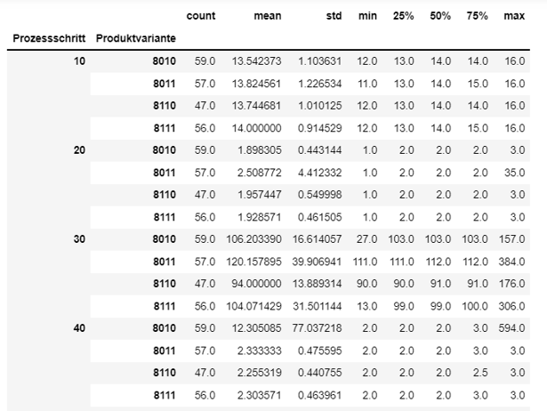

4. Data analysis
Bottleneck analysis
Detect Anomalies

Slide 25
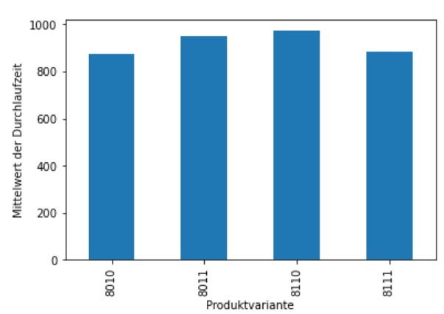
5. Data visualization and Results
Bar chart for processing times per
product variant

Slide 26
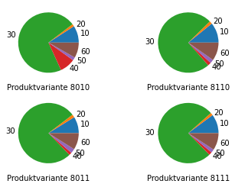
5. Data visualization and Results
Processing time per process step and
product variation

Slide 27
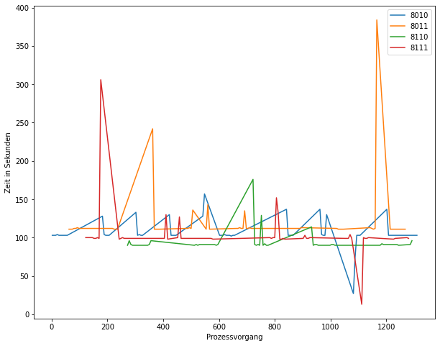
5. Data visualization and Results
Processing time per product variant for step 30

Slide 28
Thank you for listening

